Slide 1
Money in Medicine: Structural and Geographic Concentration of Industry Payments (2023)
Revealing Structural Concentration and Geographic Preferences in Pharmaceutical Industry Fund Distribution
Quinn Gan

Slide 2

Roadmap
1 | Background
2 | Research Questions
3 | Methodology
4 | Results & Dashboard
5 | Policy Recommendations

Slide 3
01
Background
The Physician Payment Sunshine Act & Transparency
Policy Origin: Enacted as part of the Affordable Care Act (ACA) to increase financial transparency in healthcare.
The CMS Open Payments Program: Mandates that pharmaceutical and device manufacturers publicly report all payments to physicians and teaching hospitals.
The Core Premise: Transparency is expected to mitigate conflicts of interest and promote accountability in clinical decision-making.
The Analytical Gap: While we know "who" received "how much," current data does not immediately clarify the structural or geographic distribution.
Research Objective: To move beyond descriptive statistics and examine the concentration of these payments in 2023.
Notes:
Good morning, everyone. Today, I am presenting my analysis of the 2023 CMS Open Payments data.
We begin with the Physician Payment Sunshine Act. This policy was a landmark intervention under the Affordable Care Act, designed to bring the financial relationships between the healthcare industry and medical providers into the light. The fundamental idea is simple: transparency should act as a safeguard against conflicts of interest.
However, there is a significant gap in our current understanding. Being transparent is not the same as being understood. While the CMS database tells us which doctors received money, it doesn't tell us the 'why' or the 'where' behind the distribution. This project aims to bridge that gap by analyzing whether industry funding is diffuse and routine, or concentrated in ways that suggest systemic policy relevance.

Slide 4
01
Background
The Nature of Industry–Physician Relationships
Diverse Financial Ties: Payments range from routine food and beverage expenses to multi-million dollar royalty and licensing agreements.
Innovation vs. Influence: While these ties can support medical innovation, high concentration in specific specialties raises significant policy concerns.
Structural Disparity: Total dollar amounts often obscure the fact that funding is heavily skewed toward device-intensive fields.
Geographic Clustering: Are payments aligned with population needs, or are they disproportionately clustered in specific economic environments?
Notes:
To understand these financial ties, we must recognize their diversity. These are not just lunch meetings. They range from small $15 meals to massive $1.19 billion royalty payments tied to intellectual property.
While industry collaboration is vital for medical innovation, it also creates hotspots for potential bias. Previous discussions often focus only on the total dollar amounts, which can be misleading.
In this study, I explore three critical dimensions that aggregate totals often hide:
First, the Structural Disparity—why do certain specialties like Orthopaedics receive so much more than others? Second, the Financial Nature—are these payments for marketing or for innovation? And finally, the Economic Alignment—are these funds being distributed based on where patients live, or where the wealth is concentrated?

Slide 5
02
Reseach Questions
Investigating the Landscape of Industry Influence
1. Structural Concentration: How are payments distributed across medical specialties and financial transfer categories (e.g., royalties vs. food)?
2. Geographic Intensity: When normalized by household counts, which states exhibit the highest payment density per household?
3. Socio-economic Alignment: Is there a statistical relationship between a state’s median household income and the intensity of industry funding it receives?
The Goal: To determine if industry financial relationships align with regional wealth patterns or clinical needs.
Notes:
With the background established, this project focuses on three primary research questions designed to evaluate the 2023 landscape of industry influence.
First, we look at Structural Concentration. We aren't just looking at the total dollars; we are asking which clinical ecosystems—like Orthopaedics or Internal Medicine—receive the most funding, and whether that money comes from routine marketing or high-value intellectual property.
Second, we address Geographic Intensity. By normalizing payments by the number of households in each state, we can identify spatial clusters of industry funding that cannot be explained by population size alone.
Finally, we test for Socio-economic Alignment. We want to know if industry payments are 'wealth-aligned'—meaning, does the money systematically follow the richest states? This has significant implications for equity and the distribution of medical resources.

Slide 6
03
Methodology & Data Integration
Technical Approach: Data Pipeline and Normalization
CMS Open Payments (2023): Processed "General Payments" to physicians, focusing on specialty and payment nature.
ACS Census Data (2024): Integrated state-level indicators including Median Household Income and total household counts.
Data Pipeline: Built a Python-based ETL process to clean, merge, and normalize datasets for comparative analysis.
Key Metric - Payment Intensity: Defined as the total industry payment amount divided by the number of households in a state.
Spatial Analysis: Utilized GeoPandas and Altair for interactive choropleth mapping and correlation testing.
Notes:
To answer these questions, I developed a technical pipeline to integrate two major data sources.
I began with the 2023 CMS Open Payments dataset, focusing specifically on General Payments. However, raw payment data doesn't provide enough context for policy analysis. To solve this, I merged the CMS data with 2024 American Community Survey data.
The core of my methodology involves a metric I call 'Payment Intensity.' By dividing total state payments by the number of households, I created a normalized 'per-household' value that allows us to compare a small state like Massachusetts directly with a large state like California. Using Python, I cleaned these datasets and utilized geospatial tools to visualize the results you will see in the following slides.

Slide 7
03
Methodology & Data Integration
Technical Approach: Data Pipeline and Normalization
CMS Open Payments (2023): Processed "General Payments" to physicians, focusing on specialty and payment nature.
ACS Census Data (2024): Integrated state-level indicators including Median Household Income and total household counts.
Data Pipeline: Built a Python-based ETL process to clean, merge, and normalize datasets for comparative analysis.
Key Metric - Payment Intensity: Defined as the total industry payment amount divided by the number of households in a state.
Spatial Analysis: Utilized GeoPandas and Altair for interactive choropleth mapping and correlation testing.

Slide 8
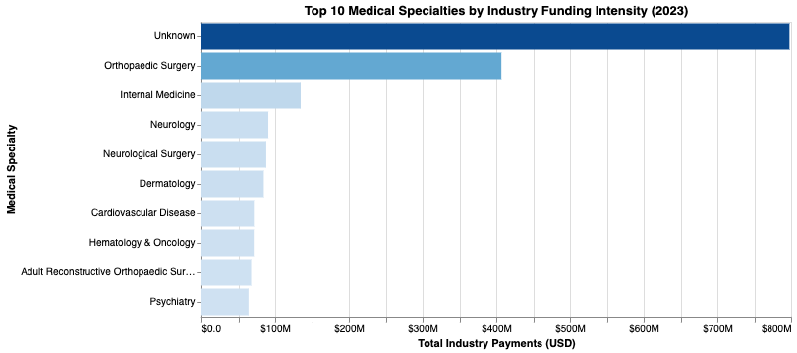
04
Result 1 - Distribution by Medical Specialty
Structural Concentration: Top 10 Specialties by Funding
Dominance of the "Unknown": Nearly $800 million flows to recipients without a registered clinical specialty in the CMS system.
Orthopaedic Surgery Leadership: Leads identified clinical fields with over $400 million in total funding.
Divergent Strategies:
High-Stakes Technical Bonding: Surgical fields like Orthopaedics and Neurosurgery receive large, concentrated payments for high-tech devices.
High-Frequency Marketing: Internal Medicine has six times the payment frequency of Orthopaedics, reflecting routine marketing coverage.
Insight: Industry sponsorship is skewed toward high-profit, device-driven disciplines rather than patient volume.

Slide 9
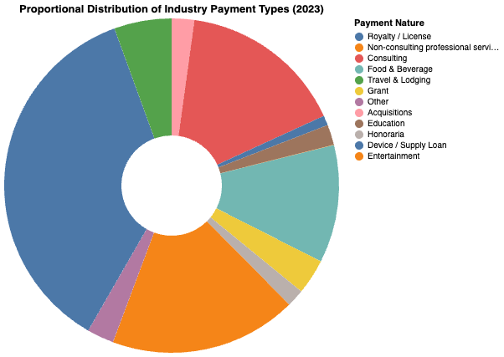
04
Result 2 - Proportional Distribution of Payment Types
The Nature of Influence: $1.19 Billion in Royalties
The Weight of Intellectual Property: Royalty and License fees represent the largest share of funding at approximately $1.19 billion.
Concentrated Incentives: These massive payments are typically monopolized by a tiny elite of influential researchers or institutions.
Professional Integration: Consulting and professional service fees represent the second tier, integrating financial interests into clinical decision-making.
Routine Penetration: Food and Beverage payments are low-value but occur with extreme frequency to maintain brand familiarity.

Slide 10
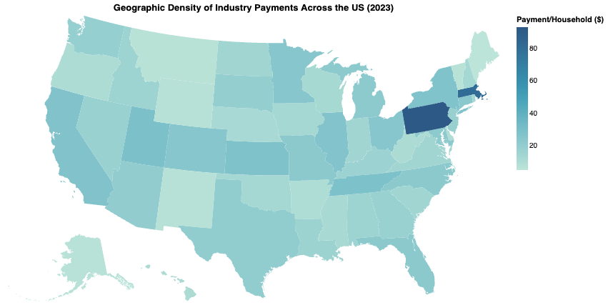
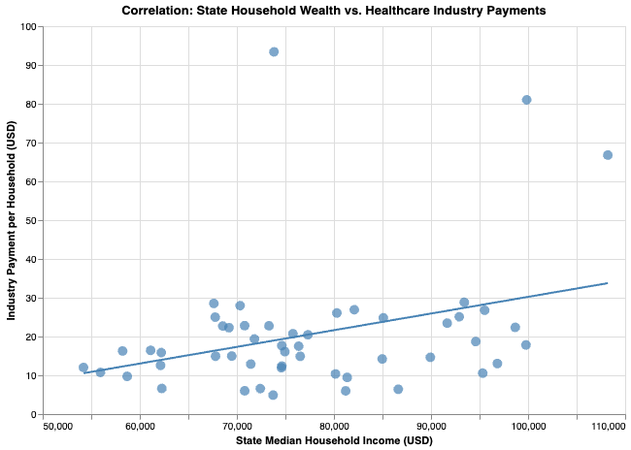
04
Result 3 - Wealth Alignment Analysis
Correlation: State Household Wealth vs. Industry Payments
Geographic Hotspots:
State-Level Intensity: Industry funding is not distributed by population; it clusters in the Northeast and Mid-Atlantic regions.
Outliers: Pennsylvania (PA) and Massachusetts (MA) exhibit the highest "Payment Intensity," driven by elite research institutions and high-value patent royalties.
The Wealth Correlation:
Market-Driven Logic: A significant positive correlation exists between Median Household Income and Payment per Household.
Finding: Industry capital systematically gravitates toward affluent states with higher purchasing power and advanced medical infrastructure.
Notes:
Next, let's look at where this money actually goes. On this slide, we combine our geographic mapping with a socio-economic correlation test.
On the left, the map reveals a striking 'Spatial Monopoly.' We see deep blue clusters in states like Pennsylvania and Massachusetts. These aren't just population centers; they are hubs of high-value intellectual property.
But why these states? The scatter plot on the right provides the answer through our 'Wealth Alignment' analysis. There is a clear, statistically significant trend: as a state's Median Household Income increases, so does the intensity of industry payments.
This tells us that industry influence is not 'needs-based'—it doesn't flow to where the most patients are or where the poorest health outcomes exist. Instead, it follows the money, clustering in affluent environments where market returns and research infrastructure are most developed. This geographic concentration suggests that transparency policies may need to be specifically intensified in these high-intensity 'Resource Islands'.

Slide 11
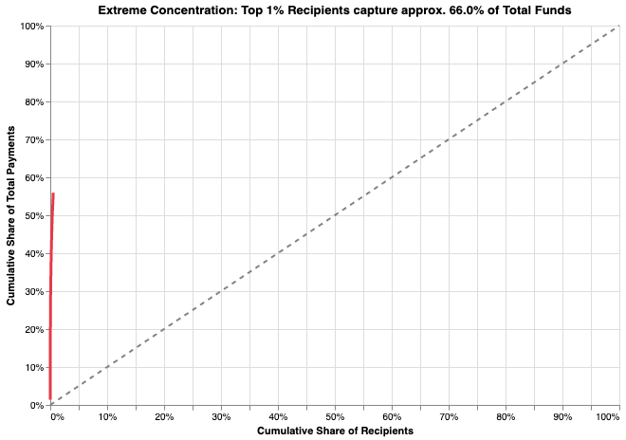
04
Result 4 - The Monopoly of Influence
Extreme Concentration: The 1% Rule
The Pareto Distribution: The top 1% of recipients capture approximately 66.0% of all industry funds.
Financial Oligarchy: A minute fraction of medical professionals, often those in "Key Opinion Leadership" (KOL) roles, wield disproportionate economic power.
Winner-Take-All System: While most physicians have high-frequency, low-value interactions (e.g., meals), the elite 1% see millions in individual payments.
Policy Imperative: Conflict-of-interest auditing should be prioritized for this top 1% who control over two-thirds of the total funding.
Notes:
Finally, we arrive at the most compelling evidence of inequality in the 2023 healthcare landscape. This concentration curve, or Lorenz Curve, illustrates a profound financial oligarchy.
The top 1% of recipients—a tiny fraction of all medical professionals—capture approximately 66% of the total industry funds. This is a classic 'winner-take-all' scenario. For the average doctor, a relationship with the industry means a free lunch; for the elite 1%, it is a primary economic driver involving millions of dollars. This finding suggests that our transparency and oversight efforts should not be spread thin. Instead, we must prioritize auditing this top 1%, as their financial ties have the highest potential for systemic impact on clinical guidelines and healthcare policy.

Slide 12
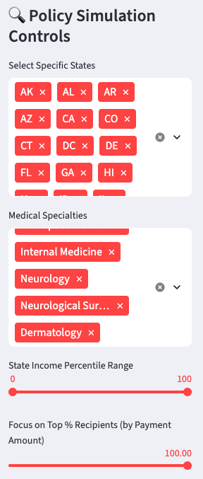
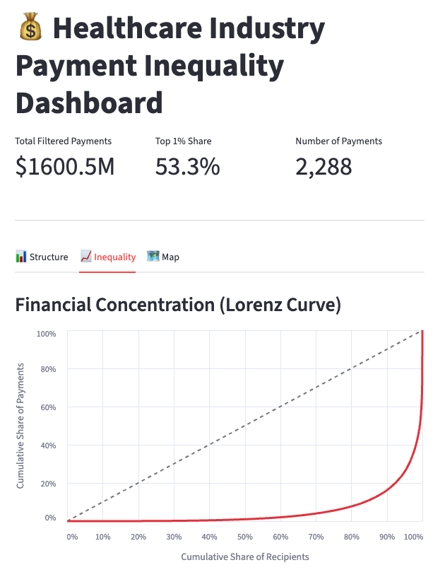
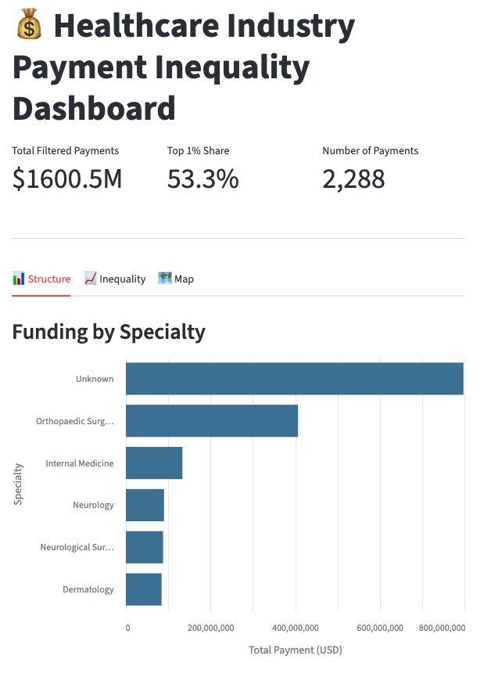
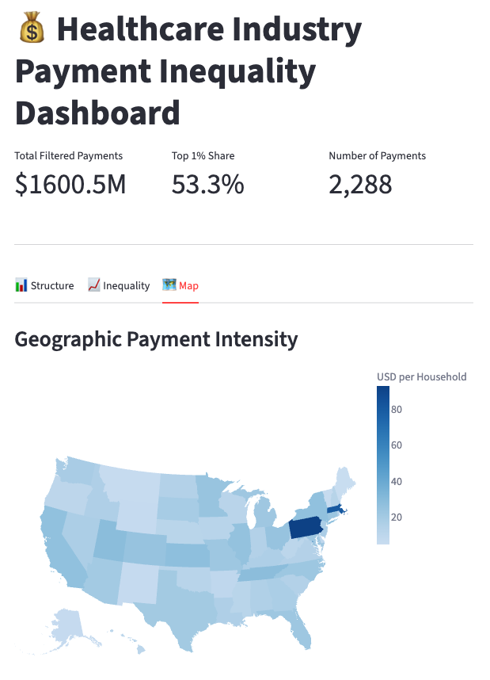
04
Interactive Policy Dashboard
Interactive Simulation: Stress-Testing Industry Influence
State & Income Percentile Sliders: Allows users to filter for specific economic environments to test the "Wealth Alignment" theory.
Specialty Selector: Isolates high-stakes surgical fields versus routine primary care marketing.
Notes:
Beyond our static analysis, we developed and deployed an interactive dashboard to serve as a policy simulation tool.
As required for this presentation, the dashboard is live at the link provided on the slide. This tool allows us to 'stress-test' our hypotheses in real-time. For instance, using the Income Percentile Slider, we can isolate the bottom 25% of states by wealth and observe a dramatic drop in total industry engagement—further validating our Wealth Alignment theory.
One of the most powerful features is the Dynamic Lorenz Curve. You’ll notice that no matter which medical specialty or state you filter for, the curve remains sharply bowed. Even in a filtered sub-set of over 2,200 payments totaling $1.6 billion, the Top 1% concentration remains extreme, often exceeding 50% to 60%.
This dashboard transforms transparency from a list of names into a functional map for regulators, helping them identify where industry influence is most concentrated and where policy interventions are most urgently needed.

Slide 13
05
Policy Recommendations
From Transparency to Accountability: Policy Implications
Targeted Conflict-of-Interest Auditing:
Shift oversight focus toward the Top 1% of recipients who control 66.0% of total funds.
Priority should be given to auditing high-value Royalty and Licensing agreements which drive systemic inequality.
Specialty-Specific Oversight:
Implement tailored transparency mandates for device-intensive fields like Orthopaedic Surgery.
Distinguish between routine marketing (food/travel) and high-stakes technical bonding (consulting/royalties).
Addressing Geographic Equity:
Develop incentives or grants to encourage industry investment and clinical research in low-income "Resource Deserts".
Supplement federal data with localized transparency initiatives in "High-Intensity" zones like PA and MA.
Empowering Public Scrutiny:
Maintain and scale interactive dashboard tools to allow patients and researchers to visualize financial ties in real-time.

